Slide 1
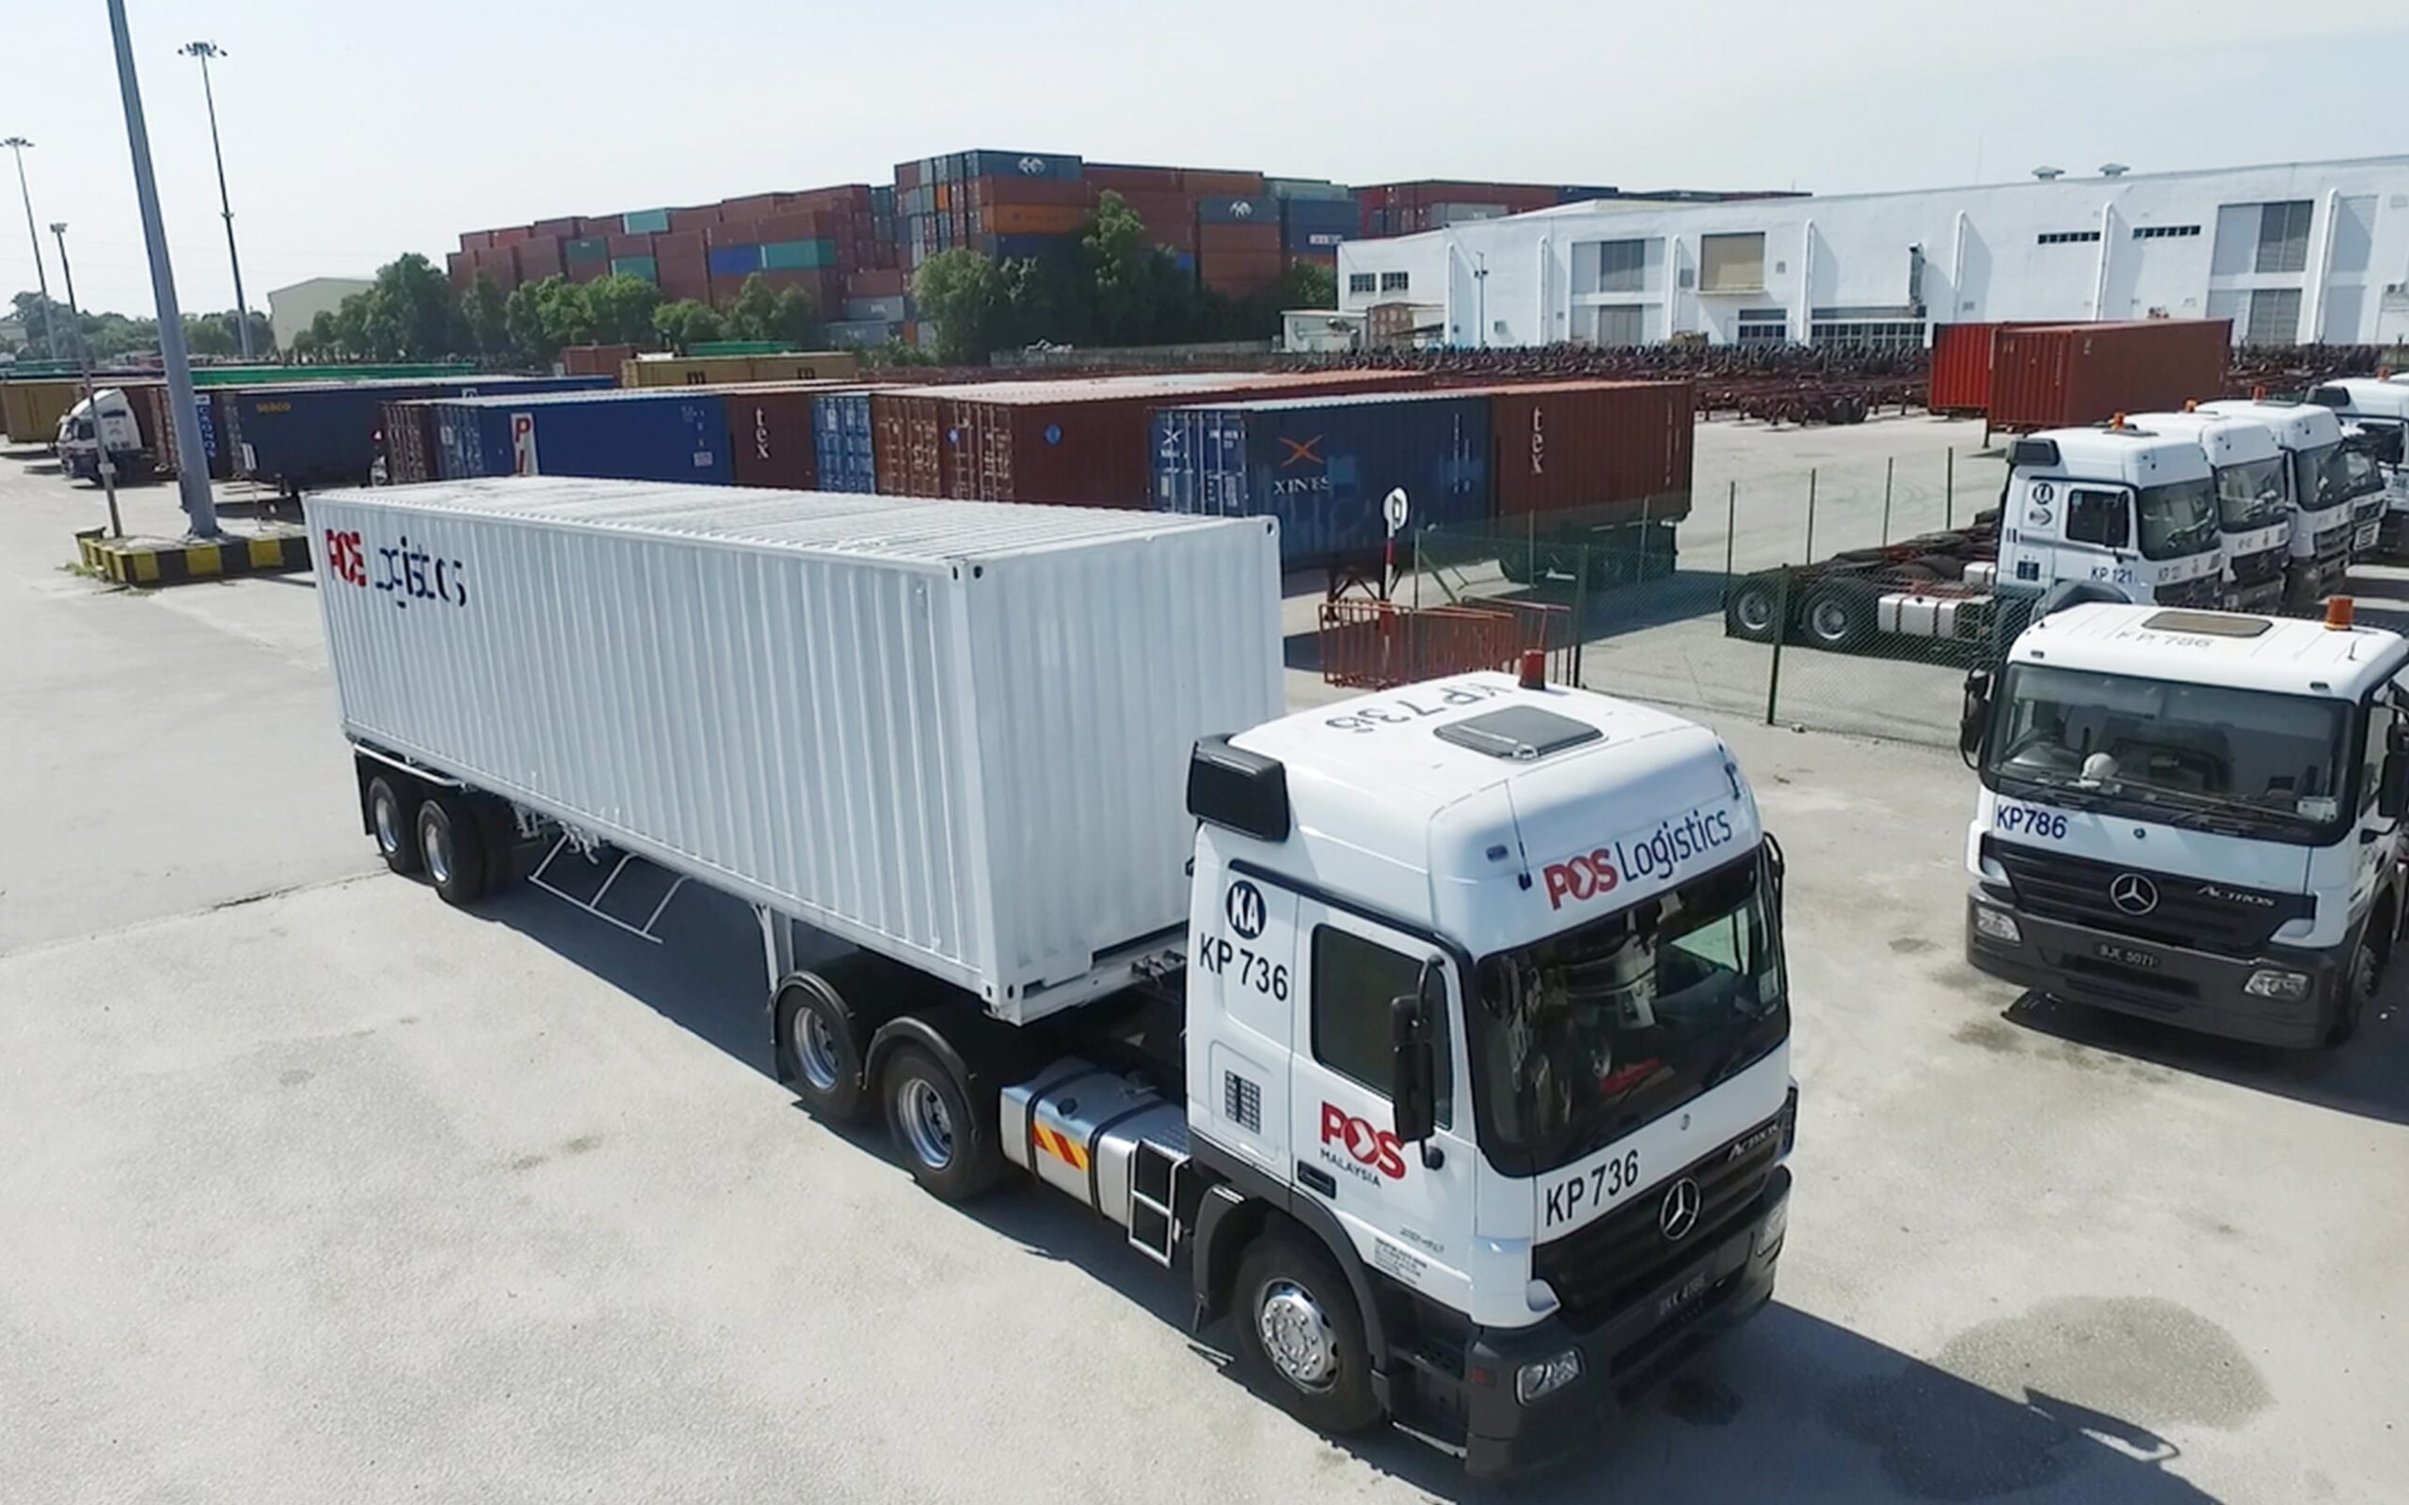

POS LOGISTICS BERHAD
Business Process Mapping
Value Chain : General Logistic Solutions
Department :
Date :
© 2026 Pos Logistics Berhad. All Rights Reserved. No part of this content may be reproduced in part or in whole, stored in a retrieval system or transmitted in any form or by any means (electronic, mechanical, photocopying, recording or otherwise) without the written permission of the copyright owner.

Slide 5

Vision
Xxx

Slide 6
Mission
Xxx

Slide 7
Key Value Chain
The purpose of this manual is to ensure PLB implement a Job Performance Manual (JPM) in order to document company’s best practices, to better satisfy the requirement and expectation of its stakeholder and to improve the overall governance of the company. This system address the design of blueprint, development of the content and delivering knowledge and practical insight to achieve OPERATIONAL EXCELLENCE.
Manage xx
Manage xx
Manage xx
Manage xx
Manage xx
Manage xx
1.0
2.0
3.0
4.0
5.0
6.0
Manage xx
7.0
Manage xx
8.0
Manage xx
9.0
Manage xx
10.0

Slide 8
Organization Chart

Slide 9
MANAGE XX

Slide 10
Key Objective
(One significant reason why your function exists in the value chain)
To xx

Slide 11
Key Result Indicators
(5-7 deliverables/outputs expected from your department/unit to meet your key objectives)
XX

Slide 12
SIPOC: Manage xx
xx
xx
xx
xx
Manage xx
Manage xx
Manage xx
Manage xx
Manage xx
Manage xx
1.1
1.2
1.3
1.4
1.5

Slide 13
ICOR: Manage xx
N/A
N/A
xxx
xxx
xxx
N/A
xxx
xxx
N/A
xxx
xxx
xxx
xxx
xxx
xxx
xxx
xxx

Slide 14
1.1.1 Deployment Chart : Manage xxx
xx
xx
xx
xx
xx
xx
cc
xxx
xxx
xxx
xxx
xxx
xxx
xxx
xxx

Slide 15
ICOR: Manage xx
N/A
N/A
xxx
xxx
xxx
N/A
xxx
xxx
xxx
xxx
xxx
xxx
xxx

Slide 16
ICOR: Manage xx
N/A
N/A
xxx
xxx
xxx
N/A
xxx
xxx
N/A
xxx
xxx
xxx
xxx
xxx
xxx
xxx
xxx
xxx
xxx

Slide 17
1.1.1 Deployment Chart : Manage xxx
xx
xx
xx
xx
xx
xx
xx
xxx
xx
xx
xxx
xx
xx
xxx
xx
xxx

Slide 18
ICOR: Manage xx
N/A
N/A
xxx
xxx
xxx
N/A
xxx
xxx
N/A
xxx
xx
xx
N/A
xxx
xx
xx
N/A
xx
xx
xx
xx
xx
xx
xx
xx
*Note:
Xx
Xx

Slide 19
1.1.1 Deployment Chart : Manage xxx
xx
xx
xx
xx
xx
xx
xx
cc
cc

Slide 20
1.1.1 Deployment Chart : Manage xxx
xx
xx
xx
xxx
xx
xx
xxx
xxx
xxx
xxx
From Previous Page
xxx
xxx

Slide 21
1.1.1 Deployment Chart : Manage xxx
xx
xx
xx
xx
xx
xx
xx
xx
xx
xx
xx
xx
x
xx
xx
xx
xx
xx

